Slide 1
Determining the Influence of Papyrus Characteristics on Fragment Retrieval with Deep Metric Learning
Intro Talk Master Thesis Timo Bohnstedt, B. Sc.
Advisors Mathias Seuret, Dr.-Ing. Vincent Christlein
Prof. Dr.-Ing. habil. Andreas Maier
Institution Chair of Computer Science 5 (Pattern Recognition)
Friedrich-Alexander-Universität Erlangen-Nürnberg (FAU)
Notes:
Determining the influence of papyrus features on fragment retrieval with Deep Metric Learning. That means my goal is to assemble papyrus fragments and learn which papyrus characteristics are important to reasable them sucessfully. Finaly, by exploiting exactly such characteristics I try to increase the accuracy of such an algorithm.

Slide 2

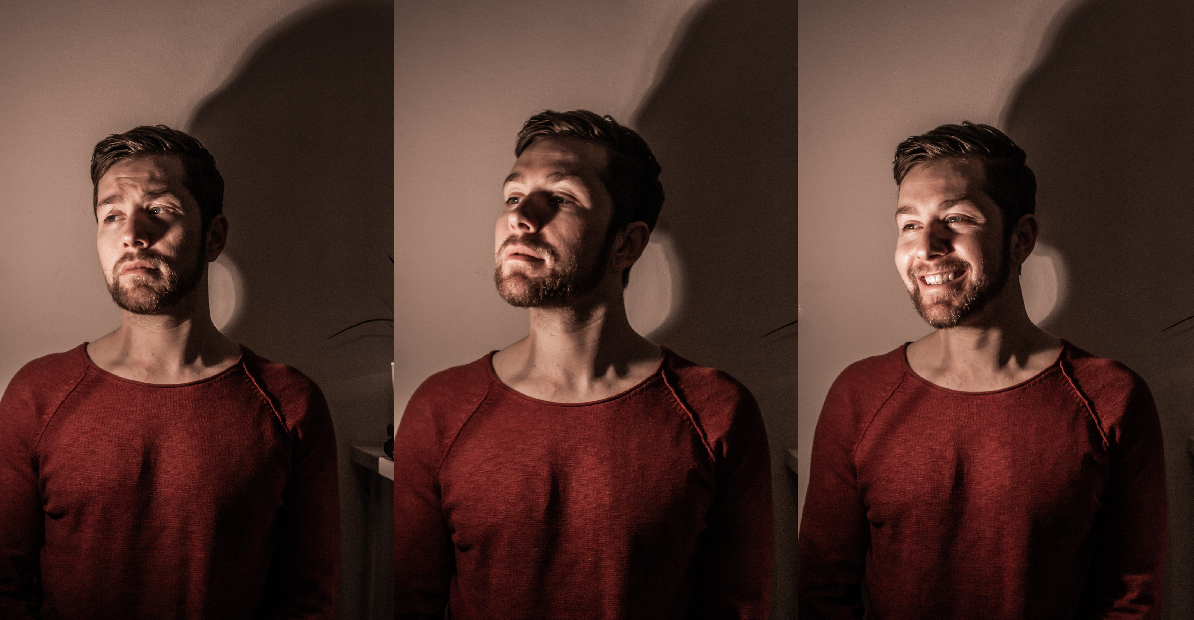
Timo Bohnstedt
Birthday 17.02.1992
Field of Study Computer Science, M.Sc.
Job Data Science @ Accenture
Residence Vienna
Extracurricular Hackathons, Mountaineering
Notes:
Before I talk about my motivation, the data, the modeling and the realted work I will introduce myself.
My Name is Timo Bohnstedt.
I am almost 30 years old and I study computer science.
Currently I also work as a data scienctist @ accenture and life in vienna.
If I am not writing my master thesis I love to participate in hackathons and to relax I go into the mountins.

Slide 3
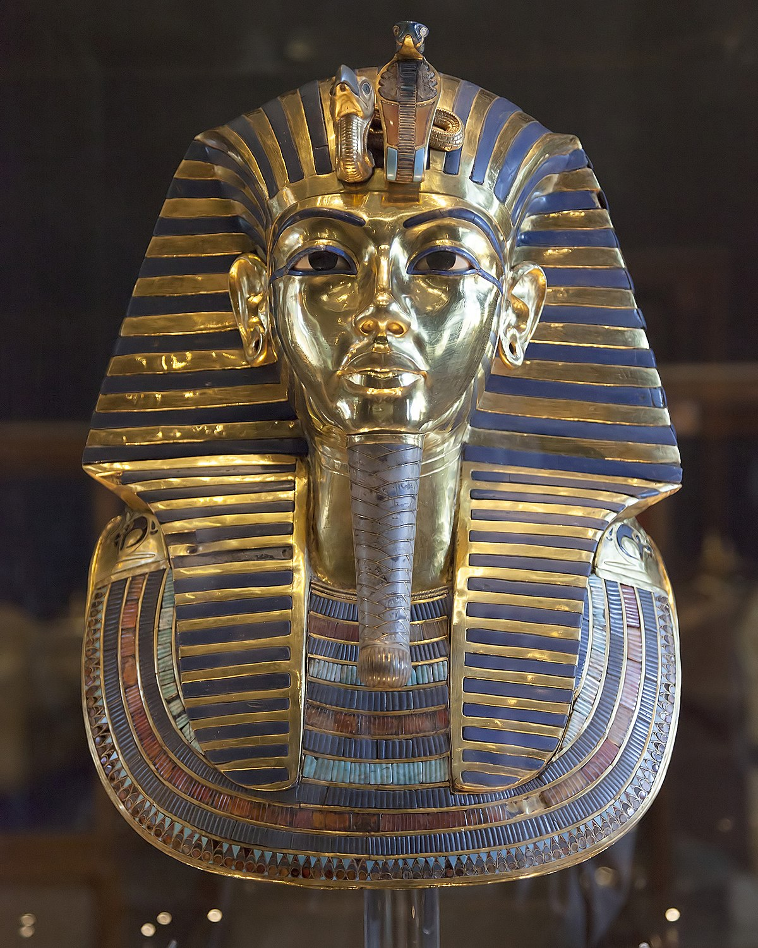
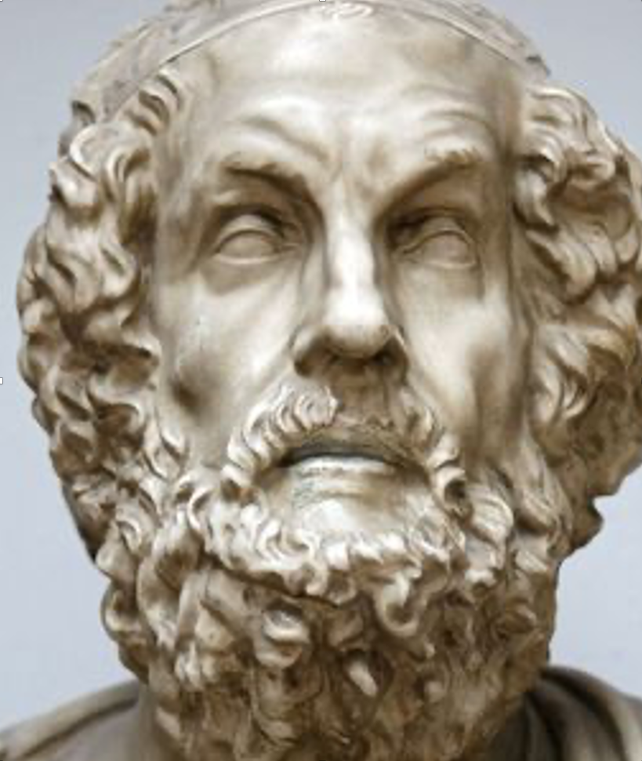
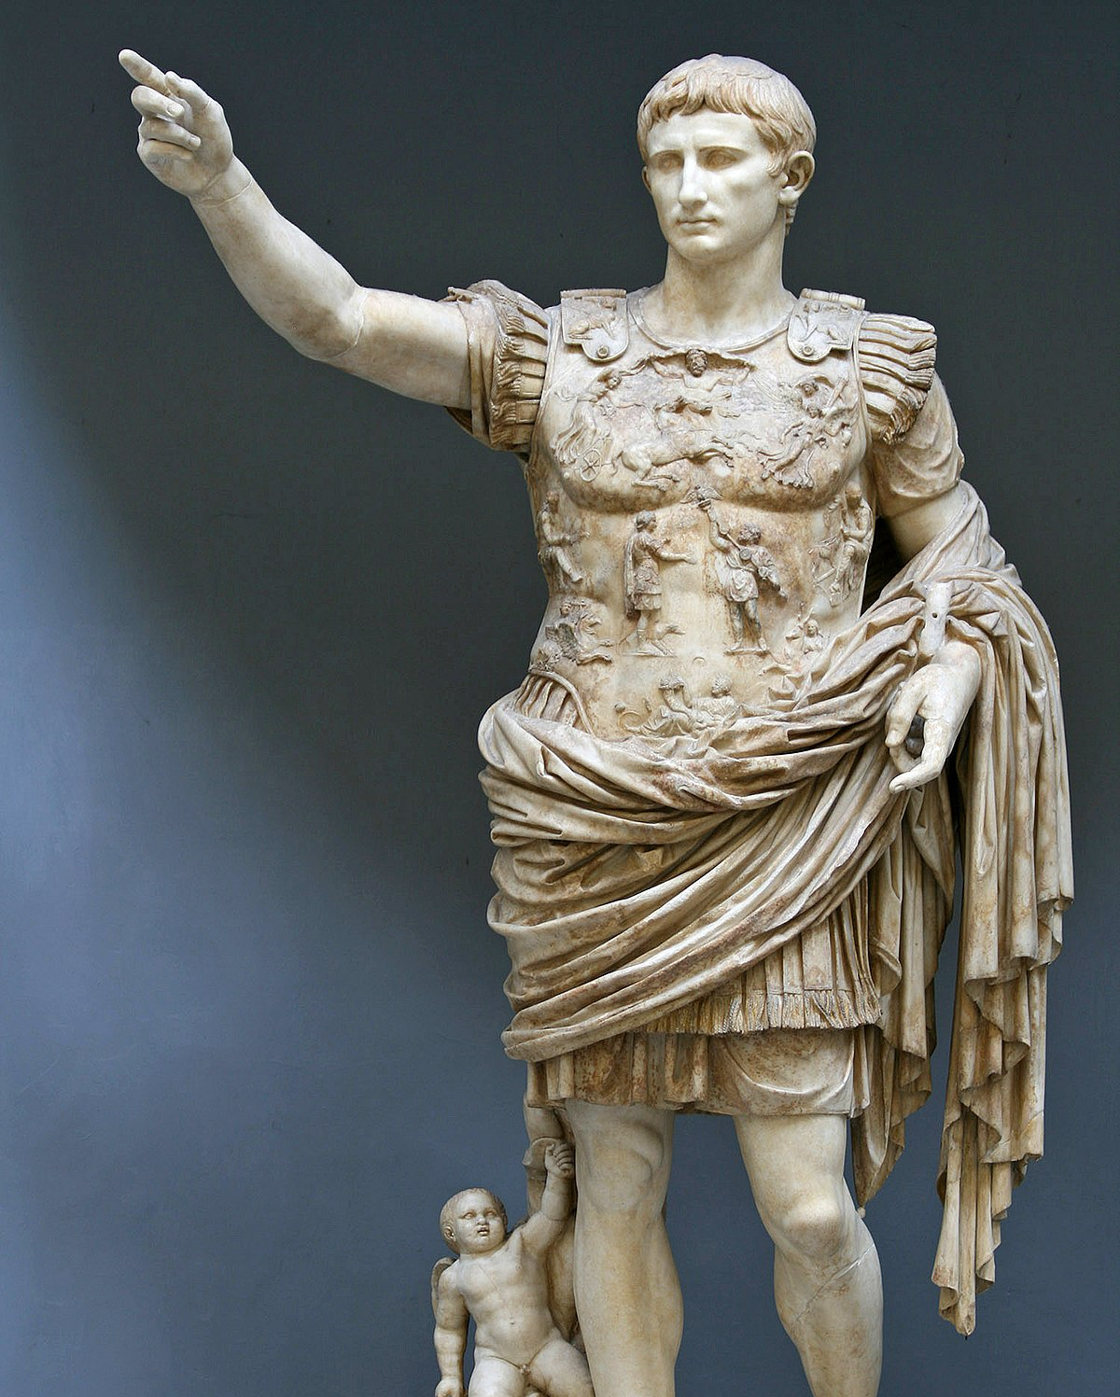
Motivation – Part I
[Dalsh A, Reuters, 2022]
[B Bernier, Adobe Stock, 2022]
[R. Gilmanshin, Adobe Stock, 2022]
Notes:
Instead of asking youself why does papyri matter you could ask yourself what do these three people have in common?
Tutankhamun, Homer, and Ceaser lived in vast empires with large administrations.
Like today, such empires produce a vast amount of information.
All three empires used paper for a long time, obtained from the papyrus plant, so-called papyri, To preserve and distribute this information.
So whether Tutankhamun's order to build a pyramid, the Odyssey poem in Original or Ceaser's letters, much of it is recorded on papyrus.
Generally speaking, If we want to understand the history of these empires and their cultural heritage, it is crucial to evaluate this papyrus.
Paper made from papyrus was the chief writing material in ancient Egypt, was adopted by the Greeks, and was used extensively in the Roman Empire.
It was used not only for the production of books (in roll or scroll form) but also for correspondence and legal documents.
This is exactly why papyri matters.

Slide 4
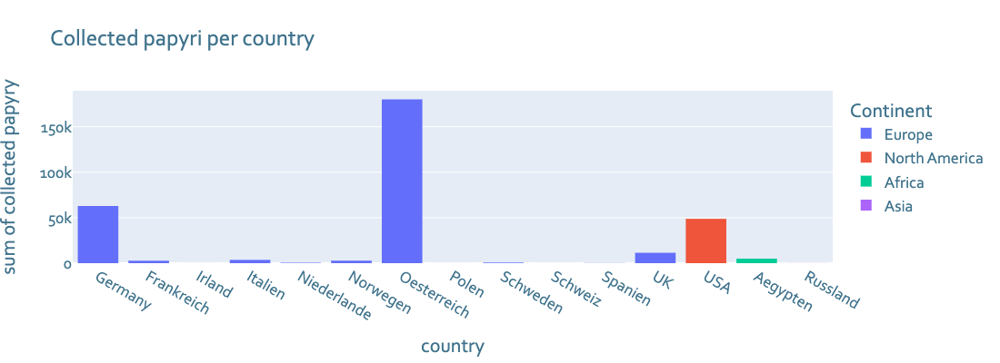
Motivation – Part II
[User Giftzwerg 88, Wikipedia 2021]
Notes:
As you can see there is a large amount of papyrus (fragments) worldwide. Not all fragments have been assembled yet. As many of you probably know, it is extremely time consuming to assemble these fragments by hand.
So, in order to help histoircans for example in vienna to reasbmle them an algorithm could do papyrologists and histroicans a great feavour.

Slide 5
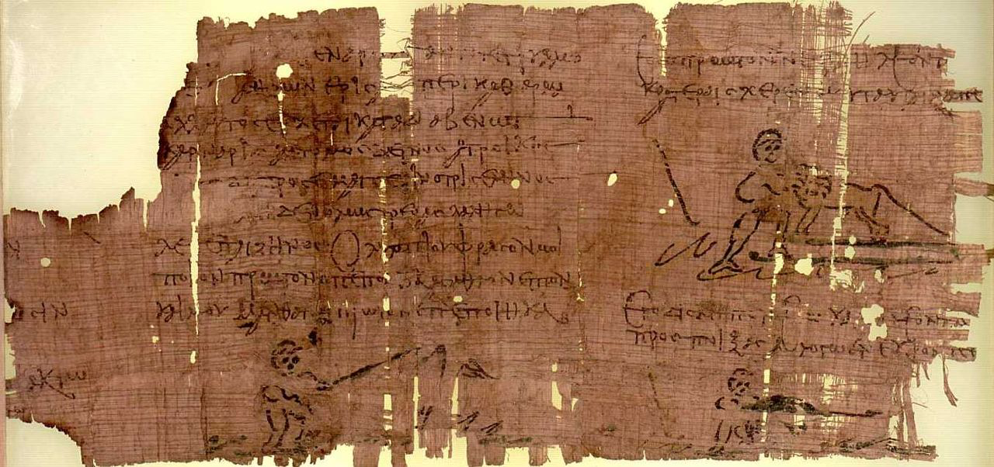
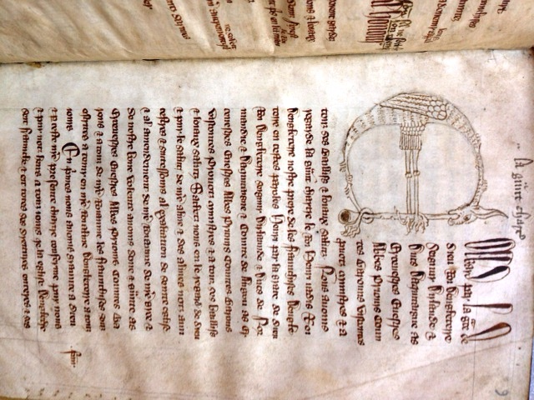
Motivation – Part III
[Sackler Library, Oxyrhynchus Pap. 2331 1954]
[K. Beck, The Harvard Law School Library Blog 2013]
Notes:
At the same time you have to know that papyrus is sensitive to mechanical stress, moisture, and worm damage, but basically exhibits surprisingly high durability. The way papyrus ages makes it particularly difficult to reassemble fragmented pieces. This is probably what distinguishes it most from other historical documents. This is also the reason why there is an increasing interest in such papyrus pieces among computer scientists working in the field of computer vision on cultural heritage.

Slide 6
Preprocessing – Part I
Notes:
As with many projects that deal with real data is that a data set must first be created. For this, the natural fragments have to be separated. For this the fragments were separated into foreground and background with the help of a histogram. Through the separated image it was possible to recognize single fragments.

Slide 7
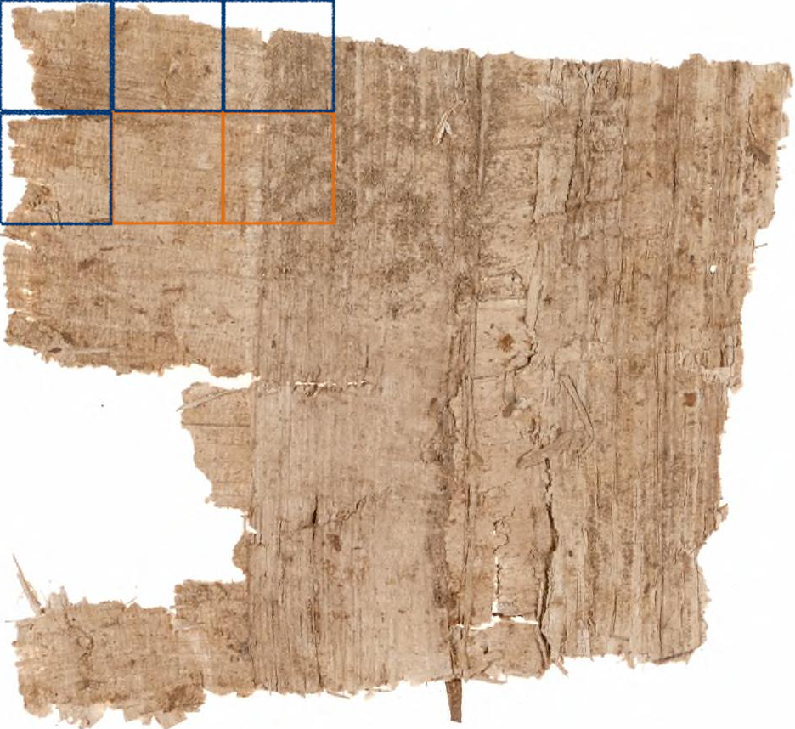
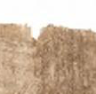
Preprocessing – Part II
Part I m x m non-overlapping patches
Part II find n useful patches via a metric
Part III go to part II
[University of Michigan Library, Papyrus Collection Pap. 1631 , 2022]
[4]
Notes:
A hugeh obstace I faced was that the images differ heavely in terms of their size. To train a network it is neccesary to get an represantive amount of data form each fragment while bring the data in a valid and useable form.
To do so I craeted a function which makes n mxm non-overlapping patches. The subset of patches are retrived by some metric for example the varinance of the fragment or "close to the mean of the original image". Each metric is based on an assumption about the realtion between fragment characteristsics and their importance. While experimenting with different metrics we get an insight of which characteristics are usefull for fragment retrival.

Slide 8
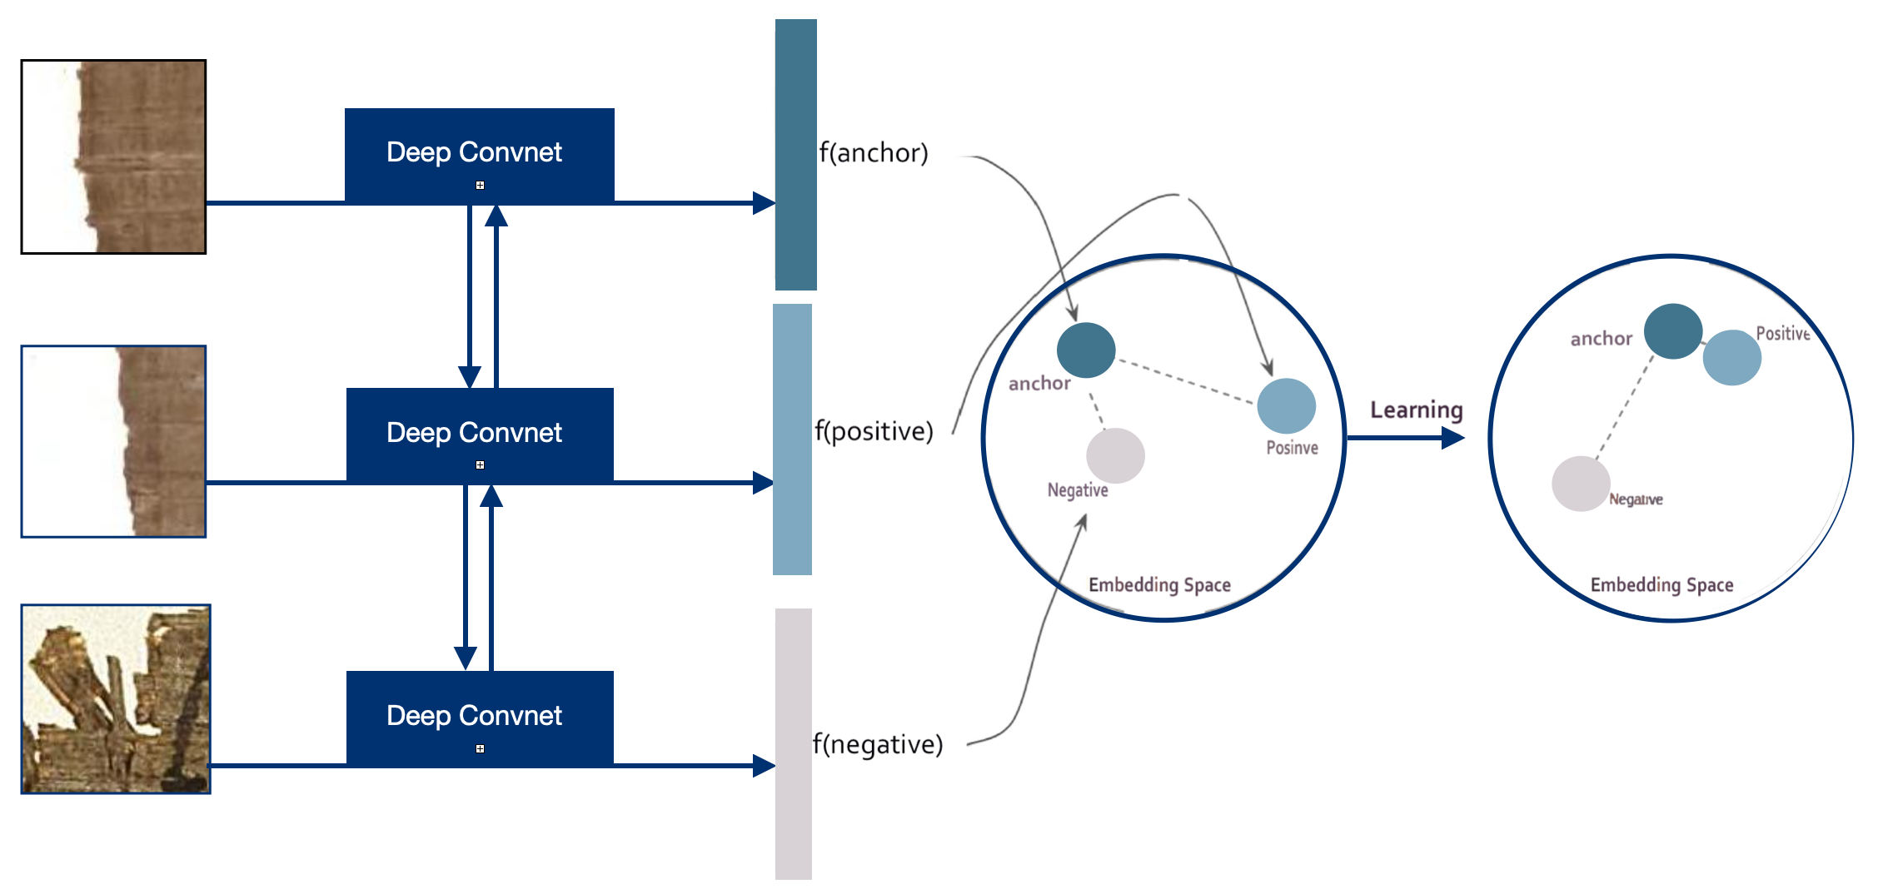
Modeling – Metric Learning
[University of Michigan Library, Papyrus Collection Pap. 1635, 2022]
Notes:
To retrieve fragments I use metric learning. That means a deep neural network learns a distance such that the embeddings which belong to positive examples are close to the anchor and the embeddings which belong to negative examples are far apart from the anchor. This approch has shown to be effective while working with papyri data.

Slide 9
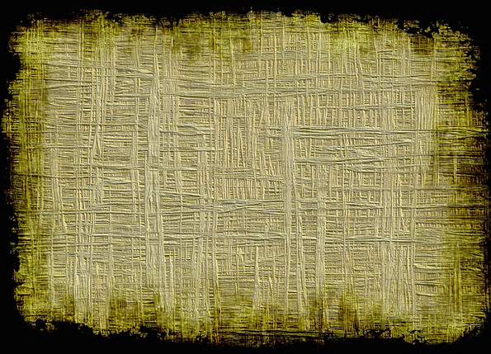
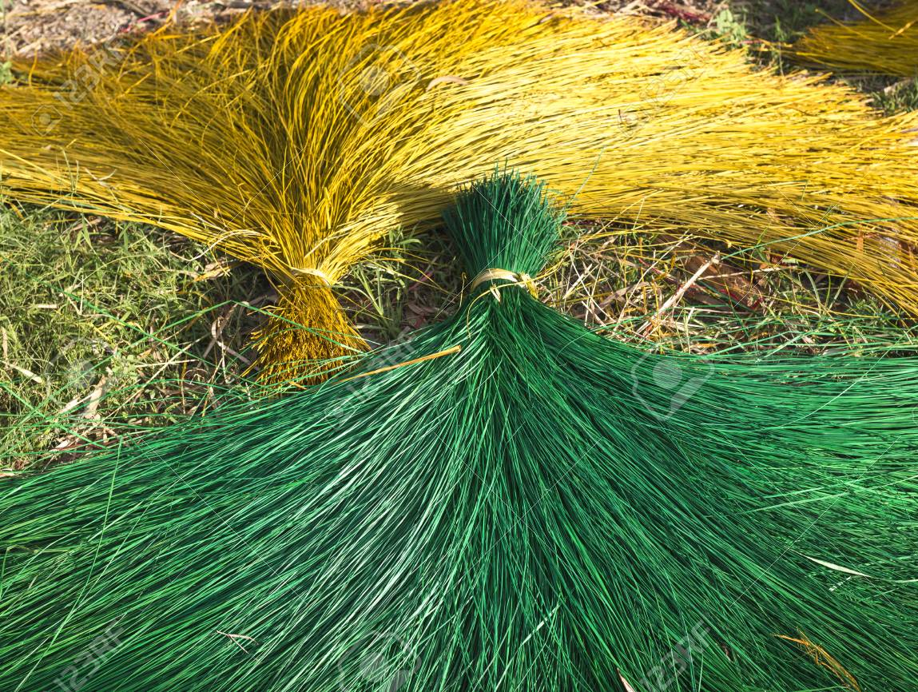
Modeling – Exploding Fibers
Part I find fibers
Part II extend fibers
Part III match fibers
[Z. Nowak, Adobe Stock, 2022]
Quangpraha, https://www.123rf.com/, 2022]
Notes:
As said papyrus is mostly made from cyperus. It gets sund dried and than its got processed as long as you can write onto it. The way how it is optiaind gives each piece of papyri a unqiue structure. Over time some of these fibers get destroid and we seek to extend the fibers who are left such that we are able to match papyrus by it's unqiue fiber structure.

Slide 10
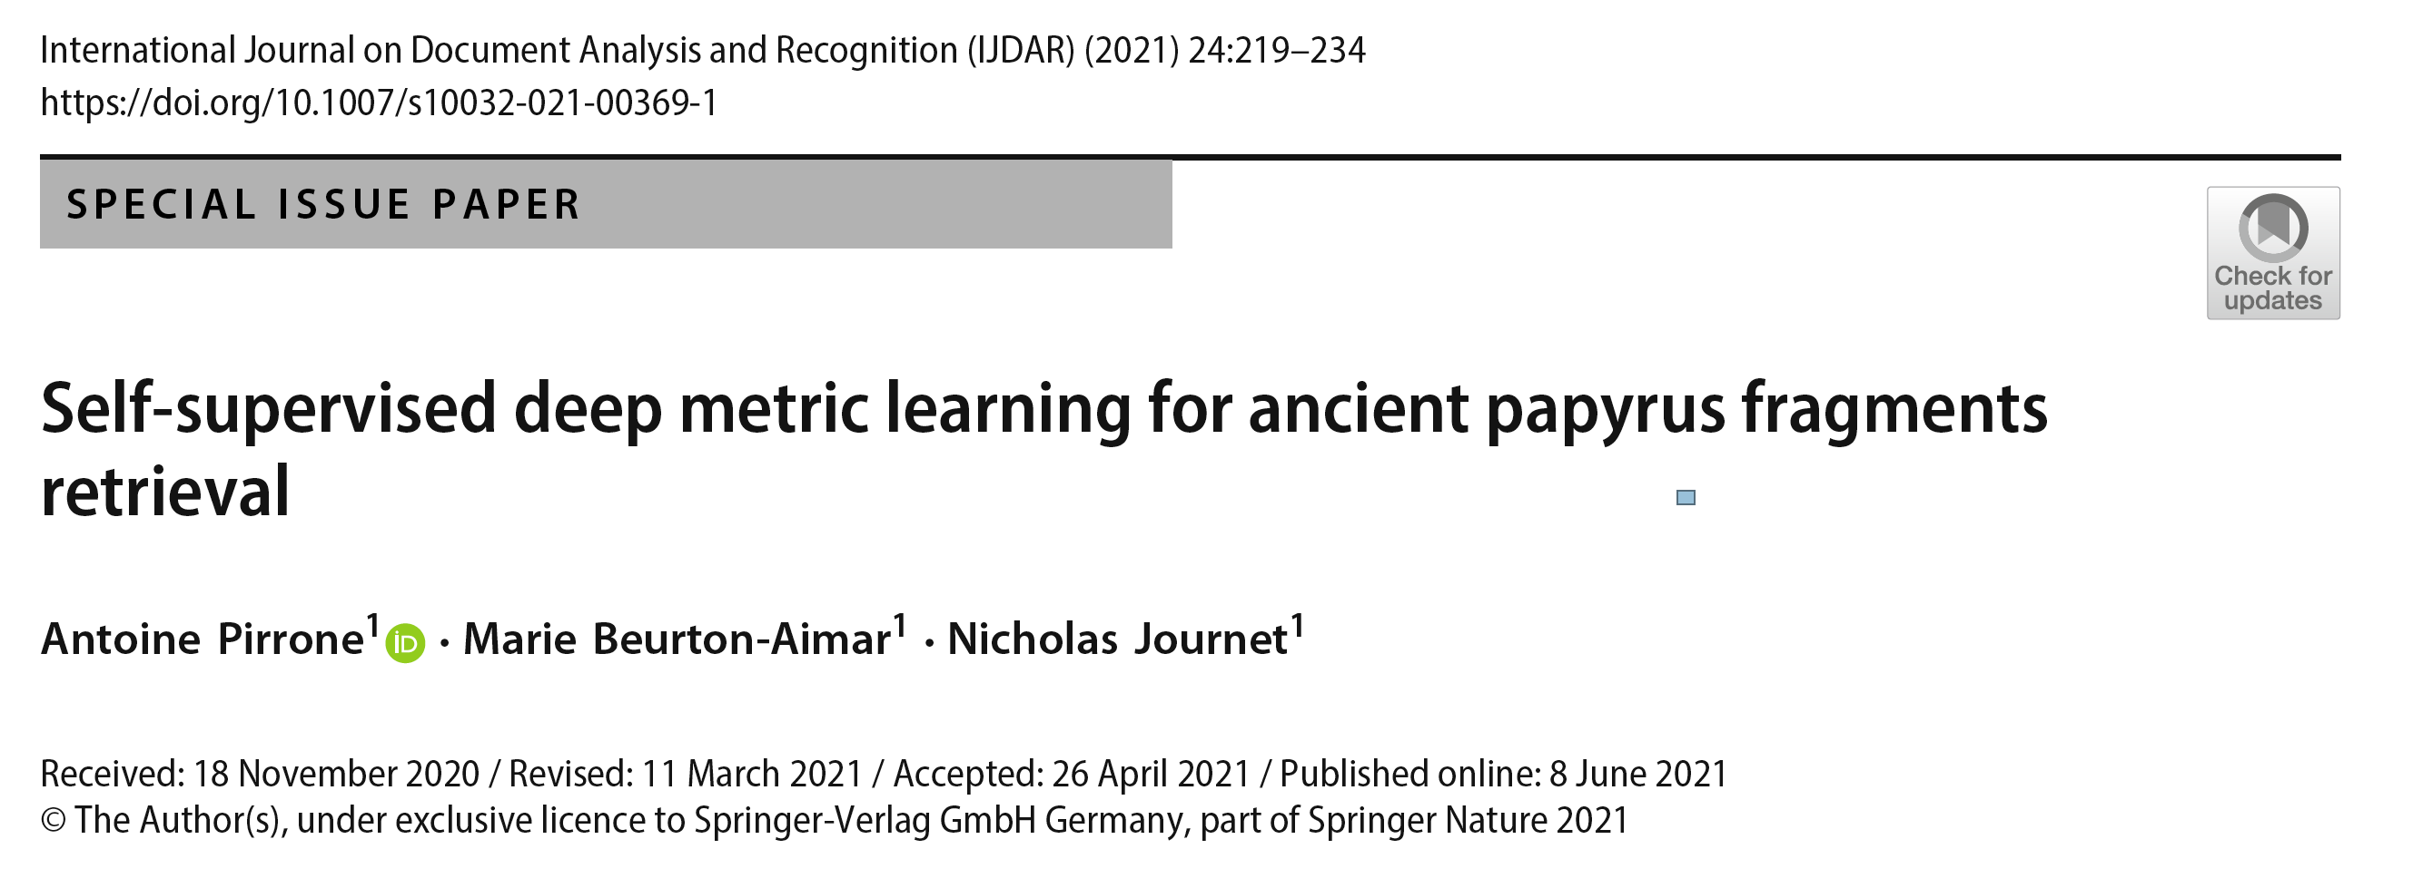
Related Work – Part l [12]
Research Gap
Complete reconstruction of the fragments
Using information of fragment-patches to assign labels to edges representing the spatial relationships between pairs.
No public dataset available to replicate the results.
Different effects of different parts of the image
(text, fibers, foreground, etc. )
[A. Pirone et al., IJDAR 2021]
Data
800 fragments (University of Michigan)
Results
Top-1 accuracy score of 0.73
Date
November 2020 – June 2021
Notes:
Self-supervised deep metric learning on ancient papyrus fragments where first used py Antoine Pirrone Marei Beurton and Nichols Jounet. In order to comapre my results I used also the Papyry Database of the Michigan Universty. Even though they reacht a very nice accuracy the paper fils of providing data for verification. Also some assumptions where made without getting into detail or proving them by doing further experiments. This I why I wanted to test the approch on similar data agian.

Slide 11
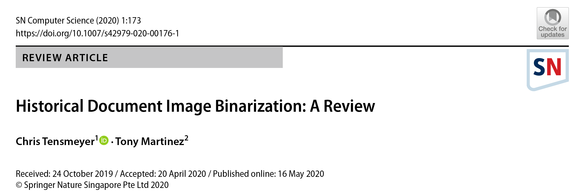
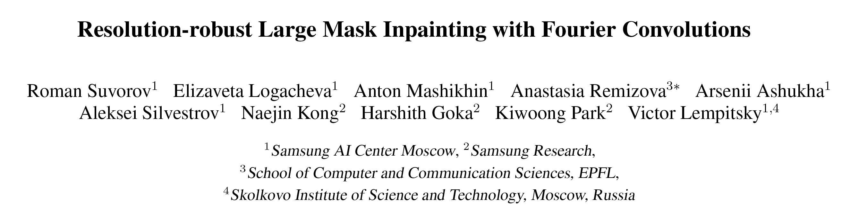
Related Work – Part ll
Binarization
Inpainting
[C. Tensmeyer et al., SN Computer Science 2020
[R. Suvorov et al., CoRR 2021
State of the art inpainting technique
Uses extensive training and huge pipeline to be able to replace parts of detected objects
Used to replace text with fibers
Review of binarization techniques for historical documents
Pointing out a trend towards papyri-documents
Notes:
As mentioned earlier I want also show that special papyrus characteristics can be used to retrive fragments and determine postitions. To find and extend the fibers it's important to separat the for and the background.
To do so I use first binarization on the images and than inpaint the text. How a stat of the art binarization on papyri data could be optioned is nicly summerized by chris tensmyer and tony martinez. In their paper they also mentioned a trend in computer vision for historical herritage from histroical data made of other matrials towards papyri data. To get ride of the text I planned to use an state-of-the art inpating as presenation by Roman Survorov and his colleques. However, it is unclear until now if this algorithm work on papyri data and if it is computial efficicent engough to be usefull in my case.

Slide 12
Research Questions
RQ 1 Which papyrus characteristics significantly affect the reassembling process of papyri fragments?
RQ 2 How can papyrus fibers be recognized, expanded and exploited to retrieve fragments?
Notes:
From my motivation, introduced approaches, and related work, the following research questions can then be derived.

Slide 13
References
[1] A. Dalsh, Reuters 2018, rt.com/news/422149-tutankhamun-egypt-leather-armor-research/, accessed 27.01.2022
[2] B. Bernier, Adobe Stock, https://www.geo.de/geolino/mensch/20831-rtkl-homer-der-beruehmteste-aller-griechischen-dichter, accessed 27.01.2022
[3] R. Gilmanshin, Adobe Stock, https://stock.adobe.com/contributor/14766/ruslan-gilmanshin?load_type=author&prev_url=detail, accessed 27.01.2022
[4] Author User Gitzwerk88, Editor Timo Bohnstedt, Wikipedia, https://de.wikipedia.org/wiki/Liste_von_Papyrussammlungen, accessed 27.01.2022
[6]Oxyrhynchus Pap. 2331 1954, Sackler Library,
http://163.1.169.40/cgi-bin/library?e=d-000-00---0POxy--00-0-0--0prompt-10---4----ded--0-1l--1-en-50---20-about-4801--00031-001-1-0utfZz800&a=d&c=POxy&cl=CL5.1.22&d=HASHa6305cc2f80678a195d4b6, accessed 27.01.2022
[7] University of Michigan Library, Papyrus Collection Pap. 1631, https://quod.lib.umich.edu/a/apis?med=1;type=boolean;view=reslist;rgn1=apis_inv;select1=phrase;q1=P.Mich.inv.%25201631,
accessed 27.01.2022
[8] Z. Novak, Adobe Stock, https://www.pixcove.com/document-text-textures-threads-backgrounds-papyrus-fibers-ugly-dirty-dull-pattern-old-dirt-texture-ancient-structure/, accessed 27.01.2022
[9] Quangpraha, 123rf.com https://www.123rf.com/photo_75985685_yellow-and-green-cyperus-sun-dried-fibers-of-sedge-papyrus-natural-fiber-growing-in-natural-wetland-.html, accessed 27.01.2022
[10] Antoine Pirrone, Marie Beurton-Aimar & Nicholas Journet, International Journal on Document Analysis and Recognition (IJDAR) volume 24, pages219–234 (2021), https://link.springer.com/article/10.1007/s10032-021-00369-1, accessed 27.01.2022
[11] Chris Tensmeyer & Tony Martinez , Self-supervised deep metric learning for ancient papyrus fragments retrieval,
Historical Document Image Binarization: A Review, SN Computer Science volume 1, Article number: 173 (2020), https://link.springer.com/article/10.1007/s42979-020-00176-1, accessed 27.01.2022
[12] Roman Suvorov, Elizaveta Logacheva, Anton Mashikhin, Anastasia Remizova, Arsenii Ashukha, Aleksei Silvestrov, Naejin Kong, Harshith Goka, Kiwoong Park, Victor Lempitsky, 1,
Resolution-robust Large Mask Inpainting with Fourier Convolutions, Winter Conference on Applications of Computer Vision (WACV 2022), https://arxiv.org/abs/2109.07161, accessed 27.01.2022
Notes:
Here are the references.

Slide 14
Summary
Milestone I create a (public) dataset
Milestone II use deep metric learning to retrieve fragments
Milestone III extend fibers and retrieve better fragments and their position
Notes:
In summary, I would like to create a Papyrus dataset first. Then I will use metric learning to reasmble papyrus fragments and lastI will investigate the effect of papyrus characteristics with respect to fragment retrival. Finally I would like to thank you for your attention. If there are still questions, I am happy to answer them.

